Slide 1
Web Engineering
Lab 4
Introduction of CSS With properties

Slide 2
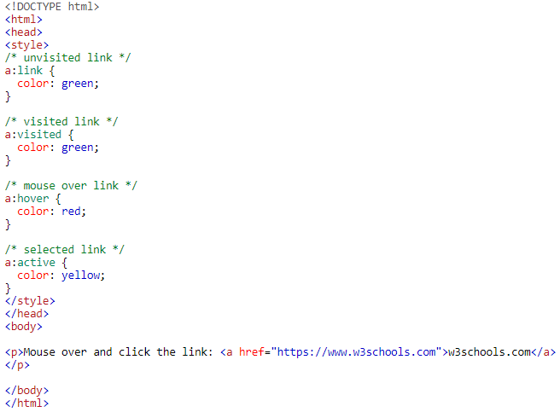
8- CSS Links

Slide 3
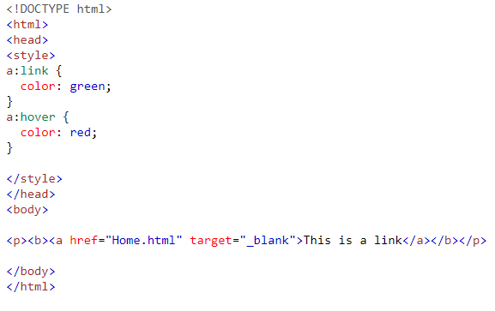
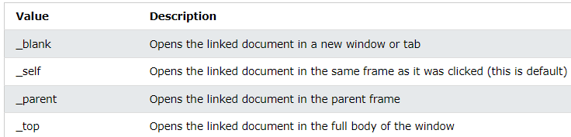

9-Target Attribute

Slide 4
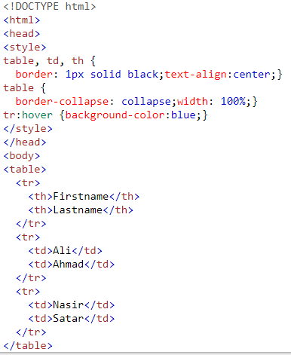


10- Tables

Slide 5

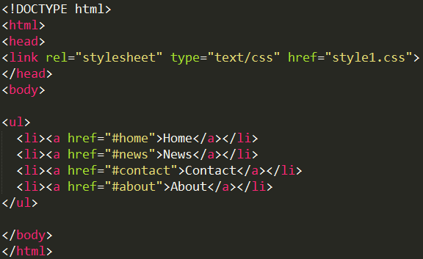
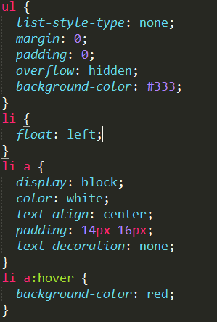
11-Navigation Bar

Slide 6
Task
CSS Display
CSS Position
CSS Overflow
CSS Float
CSS Dropdown Manu
CSS Opacity
CSS Pagination

Slide 7
Questions

